Slide 1

Case Study 59: Learn Mint : Micro Course Marketplace
By Prathamesh More

Slide 2

Index
Problem Statement
Your solution
Working (Method/Mind map)
Conclusion.

Slide 3

Problem Statement
Many students find long courses difficult to complete and prefer shorter, focused learning modules.
There is a need for a platform where users can learn through simple micro-courses that are easy to access and complete.
The goal of this project is to develop Learn Mint, a web platform where users can:
• Browse different courses • Open a course and watch lessons • Track their learning progress • Unlock lessons step-by-step
The platform aims to make learning simple, structured, and accessible.

Slide 4
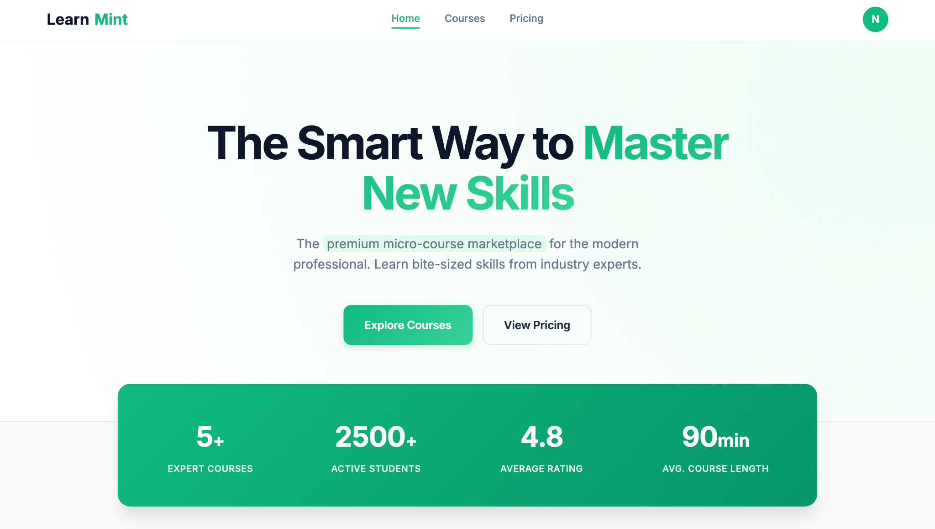
Your Solution
Learn Mint is a responsive micro-course marketplace website developed using HTML, CSS, and JavaScript.
The platform allows users to easily explore and learn new skills through short courses.
Key features of the system:
• Browse multiple micro-courses • Open course pages and watch lesson videos • Lessons unlock sequentially after completion • Progress bar to track course completion • Instructor information displayed for each lesson • Dashboard to view enrolled courses and progress

Slide 5
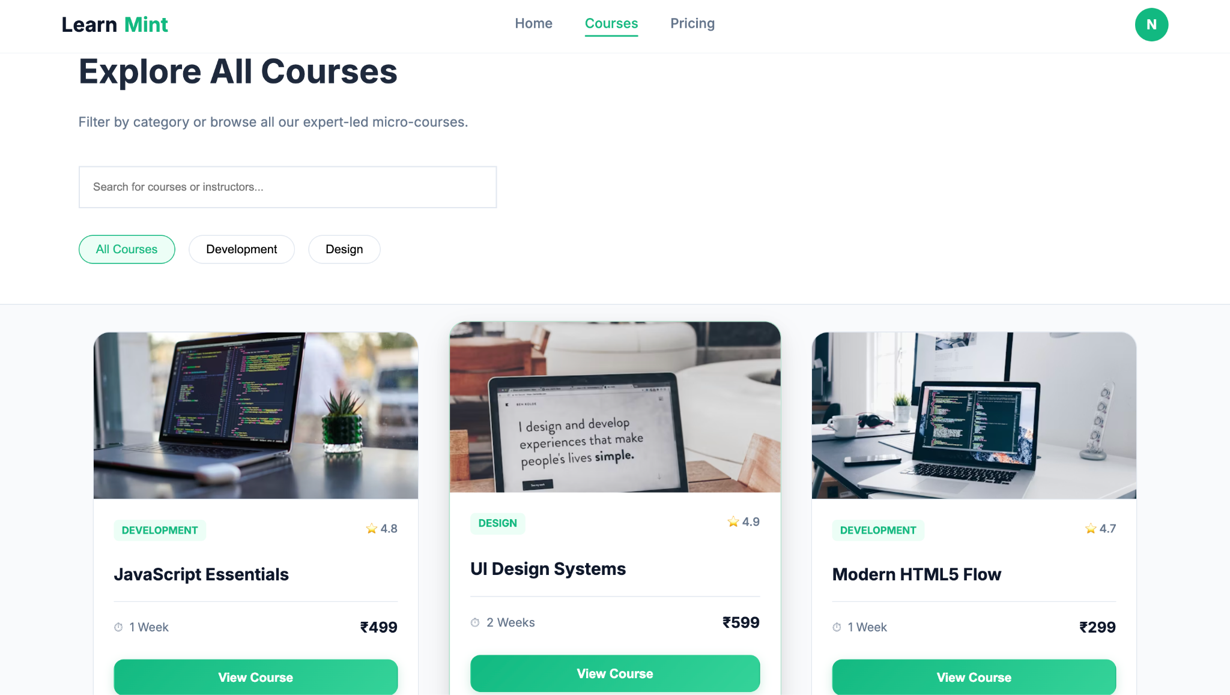
Working of the System
User opens the LearnMint website and can browse available courses.
The Courses page displays different micro-courses with details like title, rating, duration, and price.
When a user selects a course, the course detail page opens with a list of lessons and a video player.
Lessons unlock sequentially, meaning the next lesson becomes available only after completing the previous one.
The system updates the progress bar based on completed lessons.
The Dashboard shows enrolled courses and the user's learning progress.

Slide 6
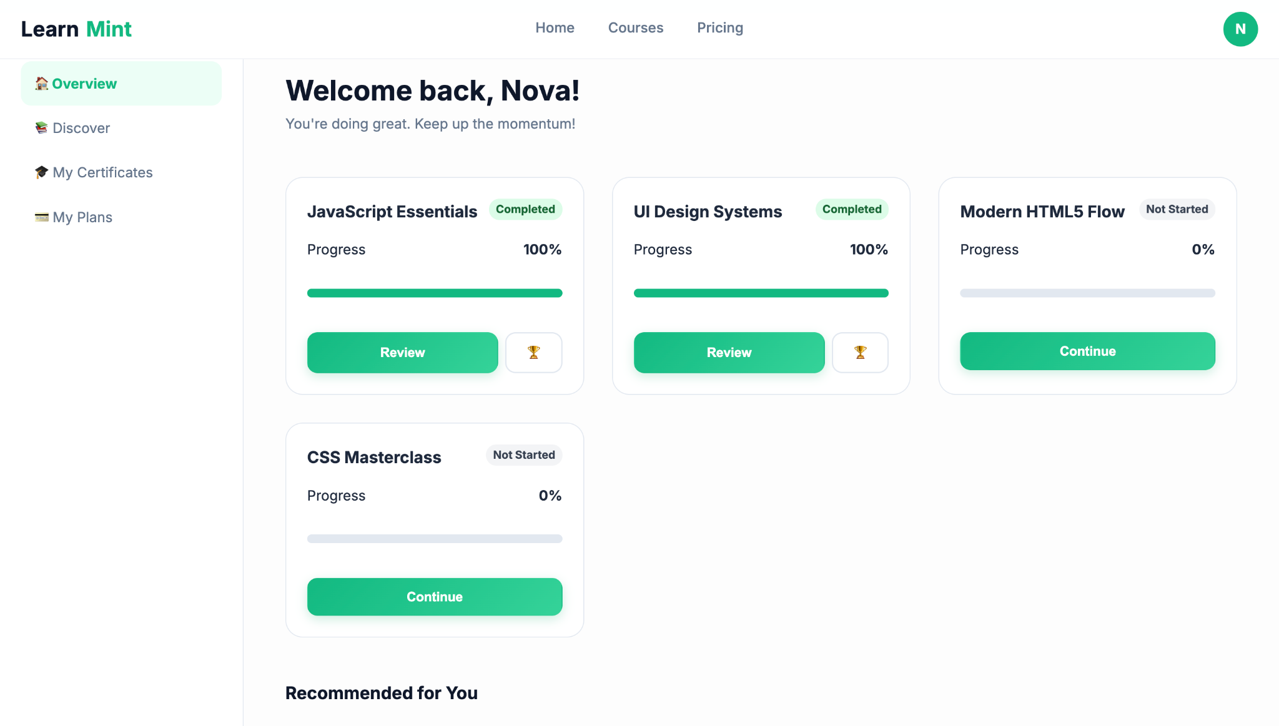
Conclusion
The Learn Mint platform provides a simple and effective way for users to learn through micro-courses.
The project demonstrates:
• A responsive multi-page website • Easy browsing of courses • Lesson-based learning system • Progress tracking for users
This project shows how HTML, CSS, and JavaScript can be used to build an interactive learning platform.

Slide 7
Thank You

